Slide 1
Christian Worldview Apologetics
Class 1

Slide 2
Is the Bible true?
Is Christianity true?

Slide 3
Is the Bible true? Is Christianity true?
This is the disciple who testifies of these things, and wrote these things; and we know that his testimony is true. And there are also many other things that Jesus did, which if they were written one by one, I suppose that even the world itself could not contain the books that would be written. Amen.
John 21:24–25

Slide 4
Is the Bible true? Is Christianity true?
“Men of Israel, hear these words: Jesus of Nazareth, a Man attested by God to you by miracles, wonders, and signs which God did through Him in your midst, as you yourselves also know—Him, being delivered by the determined purpose and foreknowledge of God, you have taken by lawless hands, have crucified, and put to death; whom God raised up, having loosed the pains of death, because it was not possible that He should be held by it.
Acts 2:22–24

Slide 5
Is the Bible true? Is Christianity true?
All Scripture is given by inspiration of God, and is profitable for doctrine, for reproof, for correction, for instruction in righteousness, that the man of God may be complete, thoroughly equipped for every good work.
2 Timothy 3:16-17

Slide 6
In what sense does the Bible claim to be true?
Objectively?
Subjectively?
What’s the difference?

Slide 7
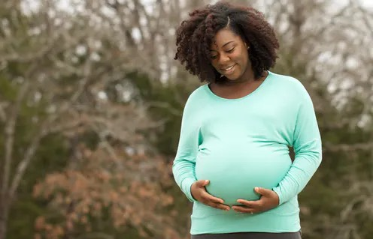
Objective Claim
I am pregnant.
A claim that corresponds with reality. Something that is true whether you agree with it or not. A statement of fact.

Slide 8
Subjective Claim
Being pregnant is so much fun!
A claim that is based on personal feelings, desires, wishes, hopes, dreams, experiences, etc.

Slide 9
Objective Truth
2 + 2 = 4
This is true regardless of how you feel about it.

Slide 10
BIG IDEA #1
In what sense does the Bible claim to be true?
Objectively
Subjectively

Slide 11
The message of the Bible falls apart unless it’s taken as a serious revelation of OBJECTIVE truth from God Himself.
Paul based his teaching on sin and salvation on a real historical man named Adam who actually disobeyed God in a real place called the Garden of Eden.
Jesus was born as a human being with a traceable Jewish genealogy extending back to Adam.
Jesus referenced the cities of Sodom and Gomorrah and their destruction as literal historical places and events.
If the Genesis account is merely a myth, then the New Testament’s teaching on sin and salvation makes no sense.

Slide 12
So…the Bible claims to be true, but can we know (objectively) with 100% certainty that it is true?
Consider a quote from Josh McDowell in his book
Answers to Tough Questions Skeptics Ask About the Christian Faith
From the chapter titled: “Can Christianity Be Proved?”

Slide 13
“Many times during conversations relating to truth, particularly religious truth, someone asks the question, “Can you prove Christianity to be true?” Most often, however, the question is phrased, “Can you say 100% for certain that Christianity is true?” The answer to the first question is yes, Christianity can be proven to be true. This of course does not mean that everyone will accept the evidence, however good it is. But the answer to the second question is, “No, not 100% for certain…The problem is a misunderstanding of the nature of proof…This is the standard used in our courts of law historically. When a judge charges a jury, he tells them to decide on probability, not certainty; based on the evidence presented, not the certainty of having viewed the crime. If jury decisions were delayed until 100% certainty existed, no verdict would ever be rendered. Everybody makes the decisions of life based on probability, not certainty. Decisions are based on a combination of faith related to fact.”
*Is he 100% certain
about this?

Slide 14
Does the Bible call people to believe
that what it says is probably true?
Does Christian faith rest upon the
probability that Scripture is a true word from God?

Slide 15
Consider another quote from Lee Strobel in his book The Case for Christ
“If you were selected for a jury in a real trial, you would be asked to affirm upfront that you haven’t formed any preconceptions about the case. You would be required to vow that you would be open minded and fair, drawing your conclusions based on the weight of the facts and not on your whims or prejudices. You would be urged to thoughtfully consider the credibility of the witnesses, carefully sift the testimony, and rigorously subject the evidence to your common sense and logic. I’m asking you to do the same thing while reading this book. Ultimately it’s the responsibility of the jurors to reach a verdict. That doesn’t mean they have 100% certainty, because we can’t have absolute proof about anything in life.”

Slide 16
GOOD NEWS!!!
God probably exists!
Christianity is probably true!
It’s very likely that the Bible contains a genuine word from God.

Slide 17
See how the Bible talks about certainty/assurance…
But he who enters by the door is the shepherd of the sheep. To him the doorkeeper opens, and the sheep hear his voice; and he calls his own sheep by name and leads them out. And when he brings out his own sheep, he goes before them; and the sheep follow him, for they know his voice. Yet they will by no means follow a stranger, but will flee from him, for they do not know the voice of strangers.
John 10:2-5

Slide 18
See how the Bible talks about certainty/assurance…
For I am persuaded that neither death nor life, nor angels nor principalities nor powers, nor things present nor things to come, nor height nor depth, nor any other created thing, shall be able to separate us from the love of God which is in Christ Jesus our Lord.
Romans 8:38-39

Slide 19
See how the Bible talks about certainty/assurance…
He who believes in the Son of God has the witness in himself; he who does not believe God has made Him a liar, because he has not believed the testimony that God has given of His Son. And this is the testimony: that God has given us eternal life, and this life is in His Son. He who has the Son has life; he who does not have the Son of God does not have life. These things I have written to you who believe in the name of the Son of God, that you may know that you have eternal life, and that you may continue to believe in the name of the Son of God.
1 John 5:10-13

Slide 20
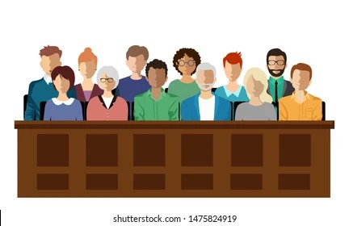
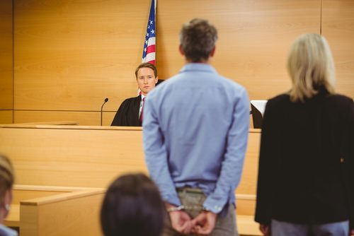
Are we jurors being presented evidence?
Or are we criminals standing trial?

Slide 21
God speaks with authority in His word.
The Bible doesn’t set out to “prove” the existence of God…it simply assumes His existence.
In the beginning God created the heavens and the earth.
Genesis 1:1

Slide 22
BIG IDEA #2
If the Bible is objectively true…
AND it claims to be an authoritative word from an
INFINITE KNOWER…
Then it must be both SELF-ATTESTING and
SELF-EVIDENCING

Slide 23
Self-Attesting:
Christian Scripture, coming to us as God’s word,
attests to its own truthfulness.
And God said to Moses, “I AM WHO I AM.”
Exodus 3:14

Slide 24
Self-Evidencing:
The ultimate proof that Scripture is what it claims to be can only come from within itself because there is no higher authority than itself.
“For when God made a promise to Abraham, because He could swear by no one greater,
He swore by Himself”
Hebrews 6:13

Slide 25
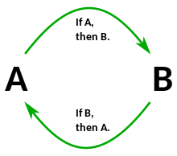
Isn’t this circular reasoning?!?!
I believe the Bible is true…because…The Bible says it’s true.

Slide 26
Consider the problems with using another standard to “test” God’s word…
It’s a theological problem.
Who or what can you appeal to in order to validate what God declares to be true?
“For when God made a promise to Abraham, because He could swear by no one greater,
He swore by Himself”
Hebrews 6:13

Slide 27
Consider the problems with using another standard to “test” God’s word…
It’s a theological problem.
It’s a moral problem.
You shall not tempt the Lord your God as you tempted Him in Massah.
Deuteronomy 6:16

Slide 28
Consider the problems with using another standard to “test” God’s word…
It’s a theological problem.
It’s a moral problem.
Yet they tested and provoked the Most High God,
And did not keep His testimonies
Psalm 78:56

Slide 29
Consider the problems with using another standard to “test” God’s word…
It’s a theological problem.
It’s a moral problem.
Jesus said to him, “It is written again,
‘You shall not tempt the Lord your God.’
Matthew 4:7

Slide 30
Consider the problems with using another standard to “test” God’s word…
It’s a theological problem.
It’s a moral problem.
It’s a logical problem.

Slide 31
Whether one’s theory of knowledge is grounded in demonstrative reasoning, common sense, or something else, this, and not Scripture becomes the ultimate authority of the one who adheres to it. It becomes more sure than the sure Word of God. The Scripture teaches us that Scripture itself is to be our authority (2 Peter 1:19, 21; 2 Timothy 3:16,17; 1 John 5:9; 1 Thessalonians 2:13). If Scripture is the final authority, and if one proves the authority of Scripture on the basis of something else other than Scripture, then one proves the Scripture is not the final authority. In other words, to prove the authority of Scripture on something other than Scripture is to disprove Scripture.”
- Michael Butler

Slide 32
Questions???

