Slide 1
Christian Worldview Apologetics
Class 2

Slide 2
BIG IDEA #2
If the Bible is objectively true…
AND it claims to be an authoritative word from an
INFINITE KNOWER…
Then it must be both SELF-ATTESTING and
SELF-EVIDENCING

Slide 3
Self-Attesting:
Christian Scripture, coming to us as God’s word,
attests to its own truthfulness.
And God said to Moses, “I AM WHO I AM.”
Exodus 3:14

Slide 4
Self-Evidencing:
The ultimate proof that Scripture is what it claims to be can only come from within itself because there is no higher authority than itself.
“For when God made a promise to Abraham, because He could swear by no one greater,
He swore by Himself”
Hebrews 6:13

Slide 5
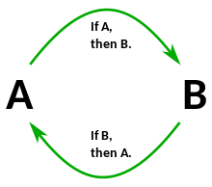
Isn’t this circular reasoning?!?!
I believe the Bible is true…because…The Bible says it’s true.

Slide 6
Consider the problems with using another standard to “test” God’s word…
It’s a theological problem.
Who or what can you appeal to in order to validate what God declares to be true?
“For when God made a promise to Abraham, because He could swear by no one greater,
He swore by Himself”
Hebrews 6:13

Slide 7
Consider the problems with using another standard to “test” God’s word…
It’s a theological problem.
It’s a moral problem.
You shall not tempt the Lord your God as you tempted Him in Massah.
Deuteronomy 6:16

Slide 8
Consider the problems with using another standard to “test” God’s word…
It’s a theological problem.
It’s a moral problem.
Yet they tested and provoked the Most High God,
And did not keep His testimonies
Psalm 78:56

Slide 9
Consider the problems with using another standard to “test” God’s word…
It’s a theological problem.
It’s a moral problem.
Jesus said to him, “It is written again,
‘You shall not tempt the Lord your God.’
Matthew 4:7

Slide 10
Consider the problems with using another standard to “test” God’s word…
It’s a theological problem.
It’s a moral problem.
It’s a logical problem.

Slide 11
Whether one’s theory of knowledge is grounded in demonstrative reasoning, common sense, or something else, this, and not Scripture becomes the ultimate authority of the one who adheres to it. It becomes more sure than the sure Word of God. The Scripture teaches us that Scripture itself is to be our authority (2 Peter 1:19, 21; 2 Timothy 3:16,17; 1 John 5:9; 1 Thessalonians 2:13). If Scripture is the final authority, and if one proves the authority of Scripture on the basis of something else other than Scripture, then one proves the Scripture is not the final authority. In other words, to prove the authority of Scripture on something other than Scripture is to disprove Scripture.”
- Michael Butler

Slide 12
Why “worldview apologetics”?

Slide 13
The ball is red.
The ball is blue.

Slide 14
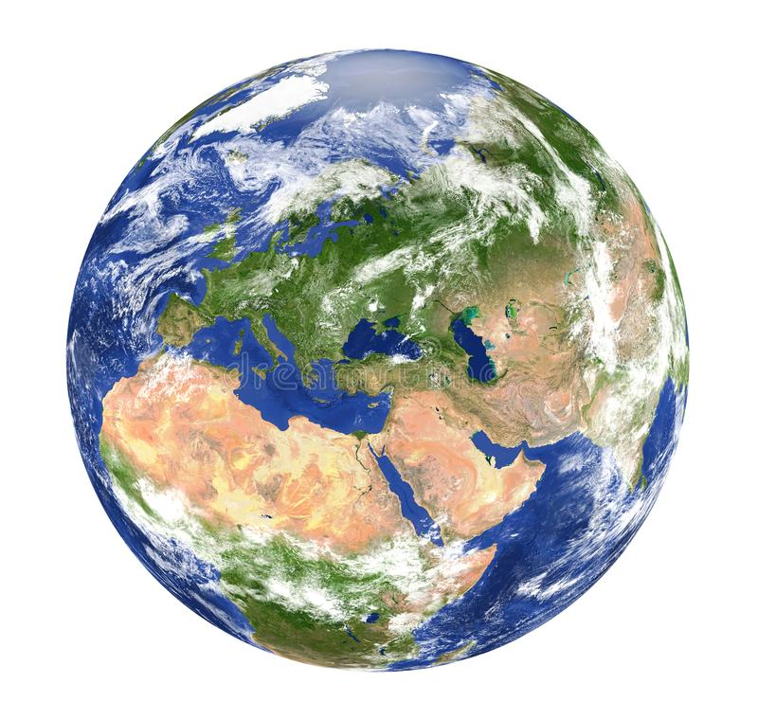
Conclusion:
“X”
Worldview
Conclusion:
NOT “X”
Worldview
Both men are looking through a “lens.”
These lenses are assumptions that we hold by faith.
EVERYONE IS LOOKING THROUGH A LENS!

Slide 15
Human
Reason
God’s creation
is amazing…
This is all a
cosmic accident…
Scripture
Both men are looking through a “lens.”
These lenses are assumptions that we hold by faith.
EVERYONE IS LOOKING THROUGH A LENS!

Slide 16
Everyone has a worldview based upon faith assumptions.

Slide 17
Standard (Wrong) View of FAITH & REASON Relationship
Reason
Faith
Complete separation,
Disconnected

Slide 18
Scriptural/Accurate View of the Relationship Between
FAITH & REASON
This is how everyone reasons, Christian or not
Reason
Faith

Slide 19
Now faith is the substance of things hoped for, the evidence of things not seen. For by it the elders obtained a good testimony. By faith we understand that the worlds were framed by the word of God, so that the things which are seen were not made of things which are visible.
Hebrews 11:1-3

Slide 20
“All who make idols are nothing, and the things they delight in do not profit; their witnesses neither see nor know…The blacksmith fashions it and works it over the coals, shaping it with hammers…he makes into a god, his idol, bows down to it, and worships it; he prays to it and says, ‘Save me, for you are my god!’…Such a person feeds on ashes; a deluded heart misleads him; he cannot save himself, or say, ‘Is not this thing in my right hand a lie?’”
Isaiah 44:9-20

Slide 21
Beware lest anyone cheat you through philosophy and empty deceit, according to the tradition of men, according to the basic principles of the world, and not according to Christ.
Colossians 2:8

Slide 22
100% Certainty
Reason
Christian Faith
Word of God

Slide 23
100% Certainty
Biblical Reasoning
Christian Faith
God, an Infinite Knower, speaks/reveals absolute truth in His word.

Slide 24
Biblical faith provides a sure basis/foundation for understanding, knowledge, thinking, and reasoning.

Slide 25
This argument is NOT a claim that we know all things…
Coherent Worldview
Biblical Reasoning
Christian Faith
God, an Infinite Knower, speaks/reveals absolute truth in His word.

Slide 26
In-Coherent Worldview
Un-Biblical Reasoning
Non-Christian Faith
False Worldviews/Religions

Slide 27
Questions???

